Slide 1
Chess Royale
By: Julian Gonzales, Joseph Canning, Victor Fong, Dan Hrubec

Slide 2
Project Description
Chess Royale is a combination of the battle royale genre of video game blended with the classic game of chess
4 king pieces start on a large, shrinking chess board and play until only one piece is left standing
There are various other mechanics with the addition of red and green tiles, which will eliminate the player, or allow the player to upgrade their player respectively

Slide 3

Project Description (cont.)
The game was created in Unity and is 2D
Game is single player with 3 simple CPU opponents
Games are configurable with the following options:
Map size
Red/green tile ratio
Rate of map shrinking

Slide 4
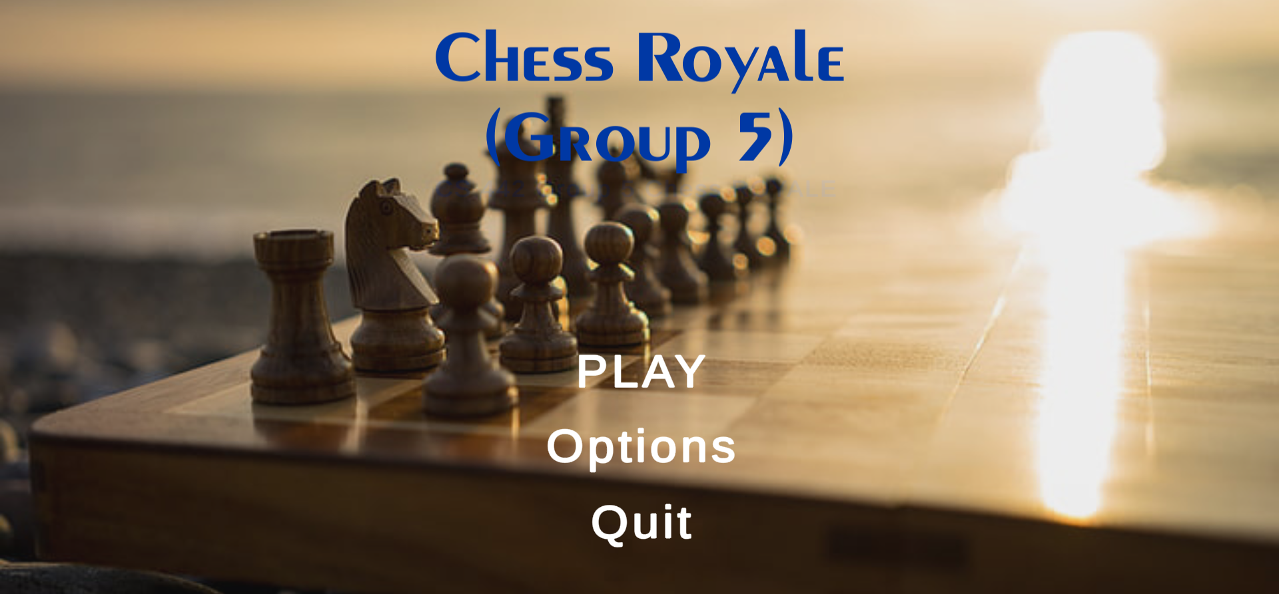
Scenario I
Created a grid system for the chess board
Added red/green tiles without functionality
Implemented pieces with appropriate movement
Made king piece playable
The Scrum methodology worked well

Slide 5
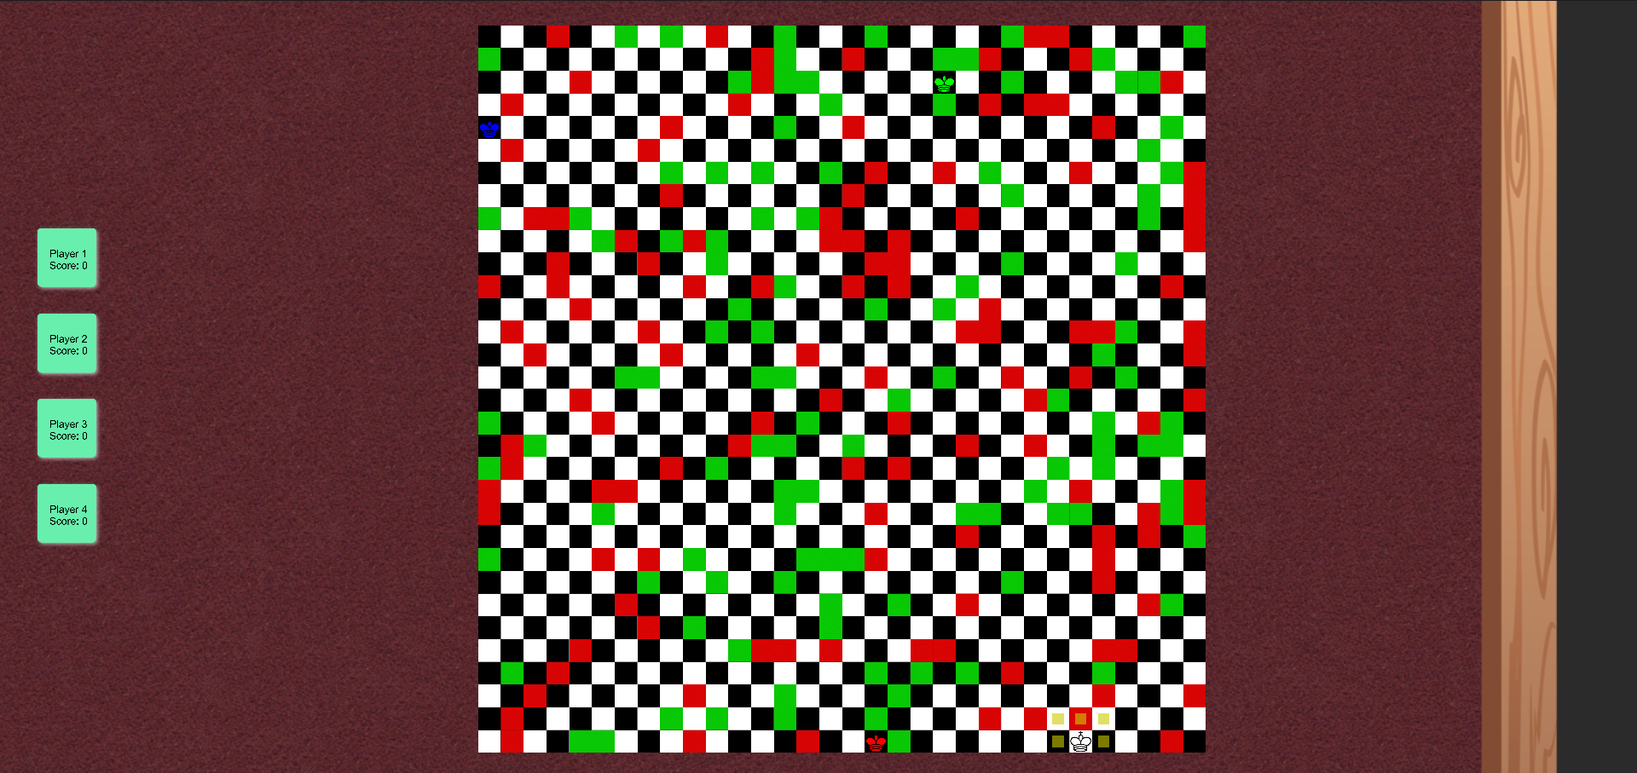
Scenario II
Added piece captures
Added functional red/green tiles
Included map options
Implemented movement indicators
Made all pieces playable
Used the XP methodology, liked pair programming over Discord

Slide 6
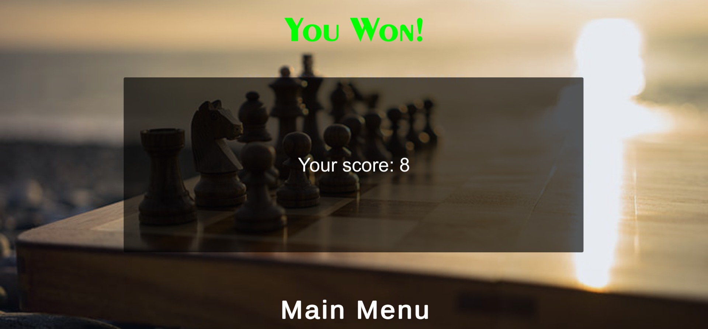
Scenario III
Fixed bugs
Added win/lose screens
Polished visuals
Included score system
Attempted to use TDD to work out our goals during this Scenario, but had limited success

Slide 7

Further Development
More options with the green tiles (e.g. allowing the player to teleport around the board)
Online multiplayer
Intelligent CPU opponents
Leaderboards

Slide 8
Thanks for listening!

Slide 9

Demo Video

